Slide 1


Slide 2
Background
Current content management systems have limitations
  The full featured systems are:
    Expensive
    Complex in installation
    Hard to use
    Need extensive customization
  The other systems don’t do the complete job
    Often archives just part of the unstructured data
    Lack of data evidence results in prejudicial bias in a court of law

Slide 3
The ECM Library Solution
A low cost, full featured system:
  Fast, thorough, extensible search
  Ease of Use from Simple to Complex Searches
  Data integrity
  Fully defensible in a court of law
  Easily configured to client’s business needs
  Administrative Ease-of-Use

Slide 4
“ECM Library provides businesses with a simple, easy to install, highly usable solution to manage and access unstructured data, or "content" - - - with fast, powerful and extensive search capability, backed-up with a solid architecture for secure access and content integrity.”

Slide 5
Fast, Extensible Search
Lightning Fast Search
Full text search on all commonly used file types
Includes attachments to emails
OCR scanned documents
Extensible search capabilities ensure requested data is retrieved
Options to access structured databases

Slide 6
Ease of Use from Simple to Complex Searches
Familiar Google-like initial search line
Advanced searches available through “Search Assistant Screen”
Content and Email detailed search screens
Able to quickly hone in a handful of documents out of a database of millions
Search results can be stored into a library that can be shared by user-created groups

Slide 7
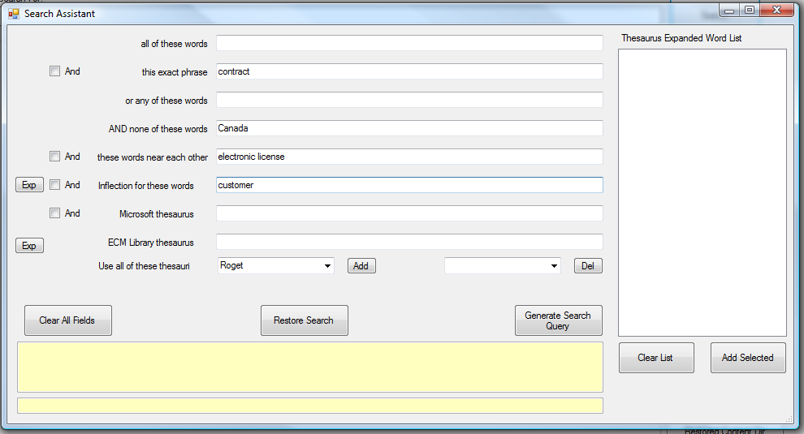

Slide 8
Full Data Integrity
Binary image archived and restored
Version tracking
Data is maintained in its exact format, it’s authenticity, accuracy and legal positioning can be verified

Slide 9
Fully Defensible in a Court of Law
Companies are expected to have business governance and processes that comply with FRCP
Without direct and easy access to existing content, companies are at risk.
ECM Library records a “Binary Image” of every file.
Reports and detailed audits can be generated against all searches that have been issued by any user in the system.
ECM Library captures all provided metadata. Versioning allows ability to capture the complete history of any document.
Enterprise wide archival governance, compliance and retention rules concerning content can be installed

Slide 10
Easily Configured to Client’s Needs
Choose which folders to automatically backup:
  Email, documents, spreadsheets, etc.
Include remote offices, independent agents etc.
Set up groups to share libraries
Defined user access privileges

Slide 11
Administrative Ease-of-Use
Fast and streamline user install
SQL Administrator doesn’t need special training
Installs can be done from a few minutes to a few hours
Retention Management Screens
Microsoft SQL features for disaster recovery and scalability

Slide 12
Low Cost
Extensible from 10 users to 100,000
Volume pricing
Server pricing
Low cost maintenance and upgrades

Slide 13
Summary
ECM Library is:
  The most complete content archival solution available.
  The most efficient
  The most cost effective
  The most legally defensible

Slide 14
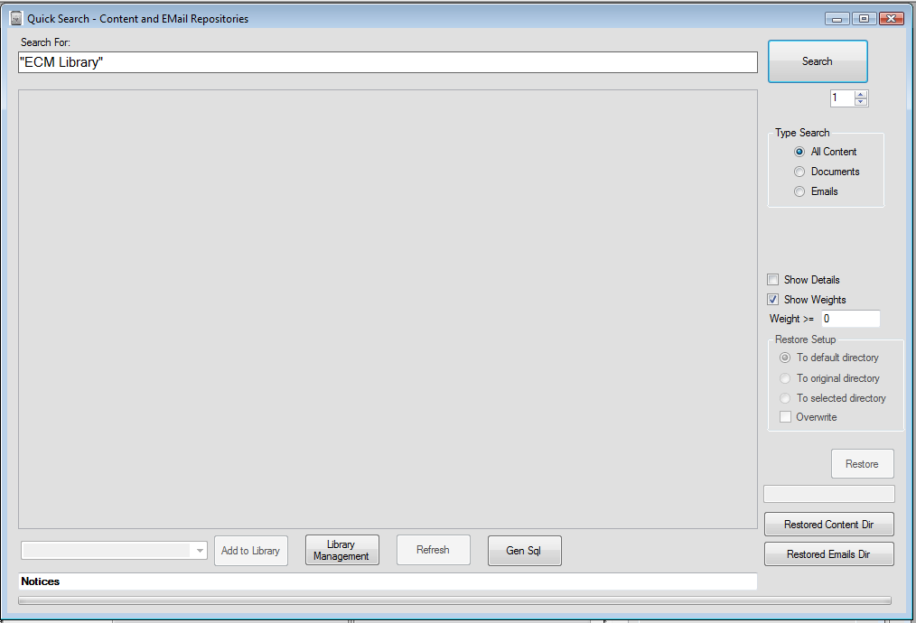

Slide 15
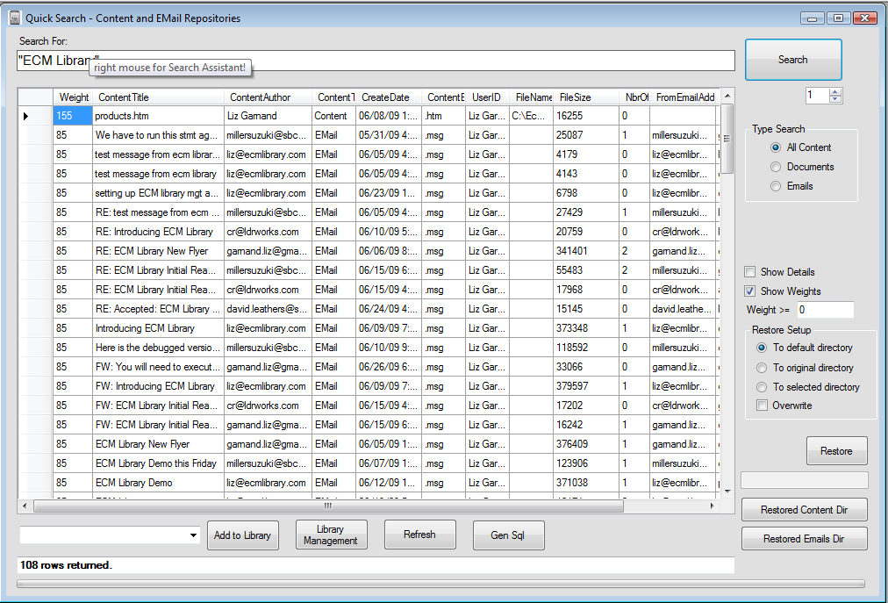

Slide 16
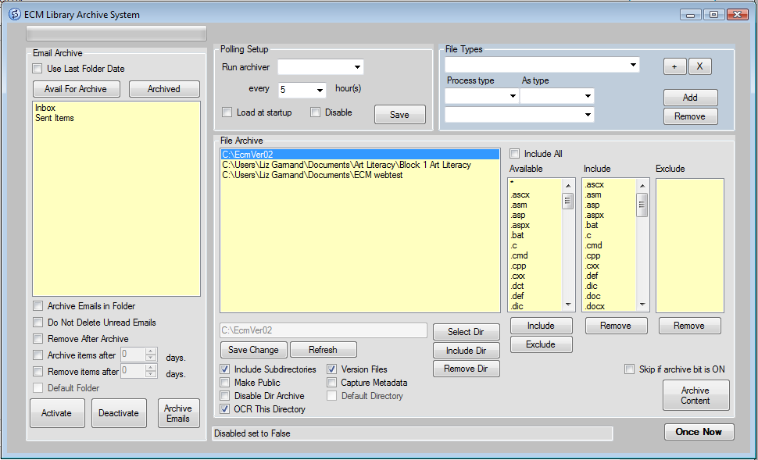

Slide 17
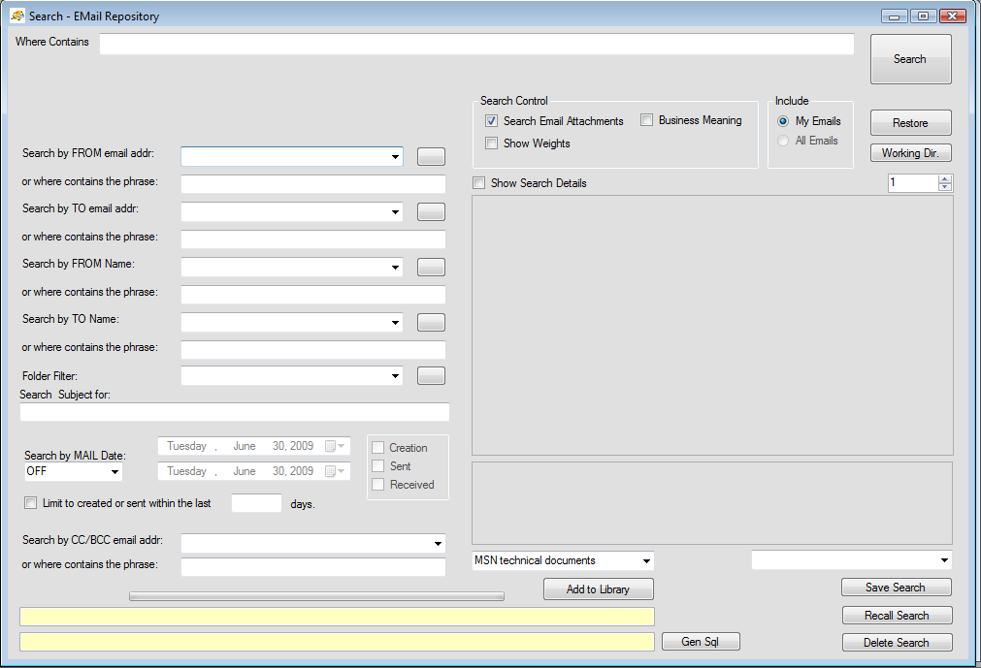

Slide 18
